Slide 1

Research Paper Recommendation System CMPE-256 Group Project
Team No. 8
Purva Deekshit (013749723)
Shreya Halagahalli Shrinivas (013821405)
Maulin Bodiwala (013733590)
Kiran Kumar Bijjala (013772551)
Siddartha Reddy Maryada (013849238)

Slide 2
Motivation
Provide researchers with useful publications at any time, place and form.
Offer the right publication to the right researcher in an efficient way.
Save time spent on looking for relevant research papers.

Slide 3
Classical Approaches and Challenges
Fetch query asking to provide specific information.
Follow a list of references from already referenced papers. Does not guarantee full coverage of research papers.
Insufficient in tracing papers published after the referenced papers.
List of references may not be publicly available and hard for researchers to access.

Slide 4
Our Approach
Hybrid Recommendation:
Provide more accurate and relevant recommendations.
Combination of collaborative, content-based filtering and deep learning approach.
User information and item description for content-based filtering.
Similarity score between users for collaborative filtering.
Deep learning neural network approach to find implicit features of items and user choices.

Slide 5
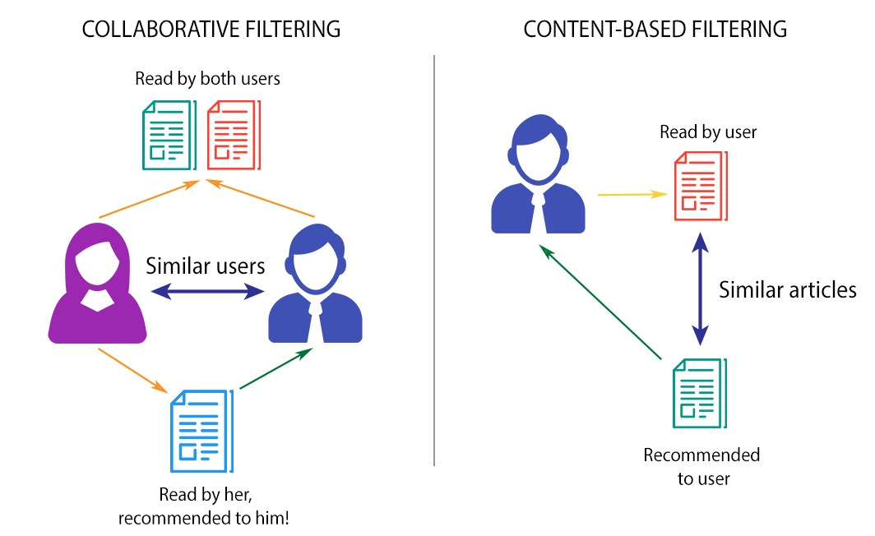
Hybrid Recommendation
Hybrid Recommendation System

Slide 6








Flow Diagram of Hybrid Approach
Query user information and research paper title
Search user in database with given ID
Identify the previous referenced papers
Get keywords from summary of previous papers using TF-IDF and compare with summary of other papers
Get similar users who have referenced similar papers
Calculate related topics using deep learning
Recommend top N papers to the user

Slide 7
Research Paper Data Collection
Research paper metadata collected from arXiv website using arXiv APIs.
Link: https://arxiv.org/help/api#documentation
Paper Metadata :
Data is pulled for multiple categories.
For example: cs.AI, cs.CE, cs.SE, cs.GR, cs.NI, cs.DB.
Sample fields: title, authors, summary, primary category, affiliation, journal reference, doi, etc.

Slide 8
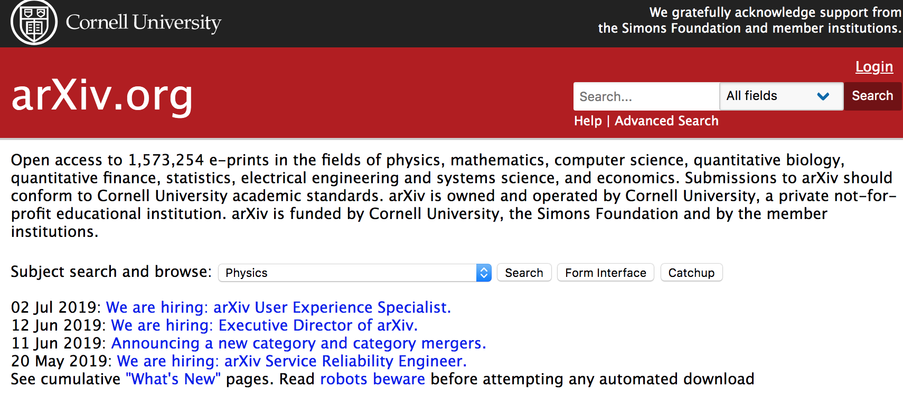
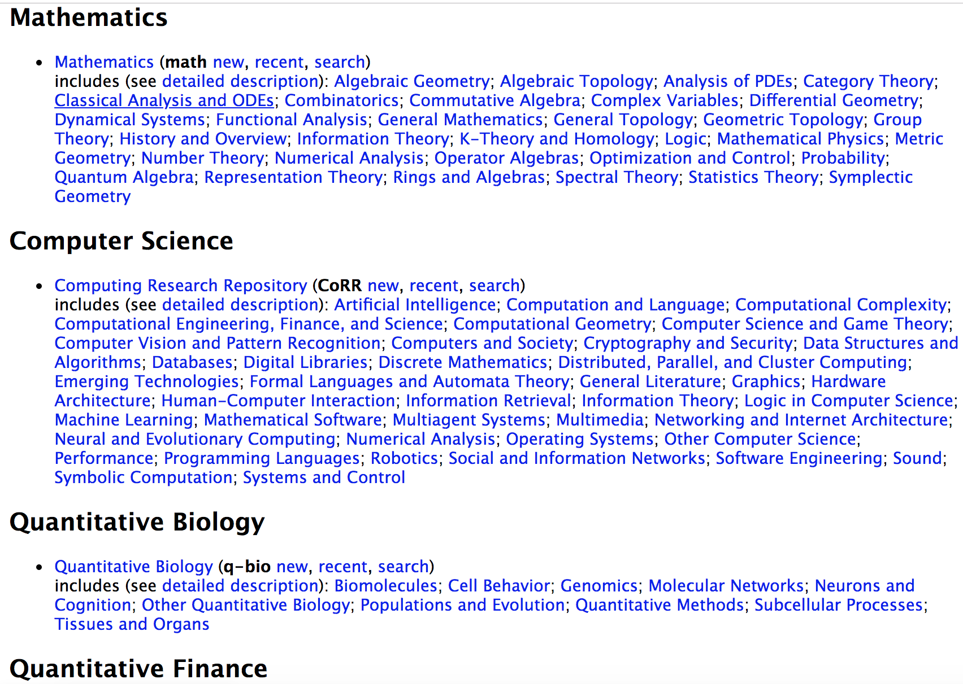
Research Paper Data Collection
Sample data from arXiv API showing available categories:

Slide 9
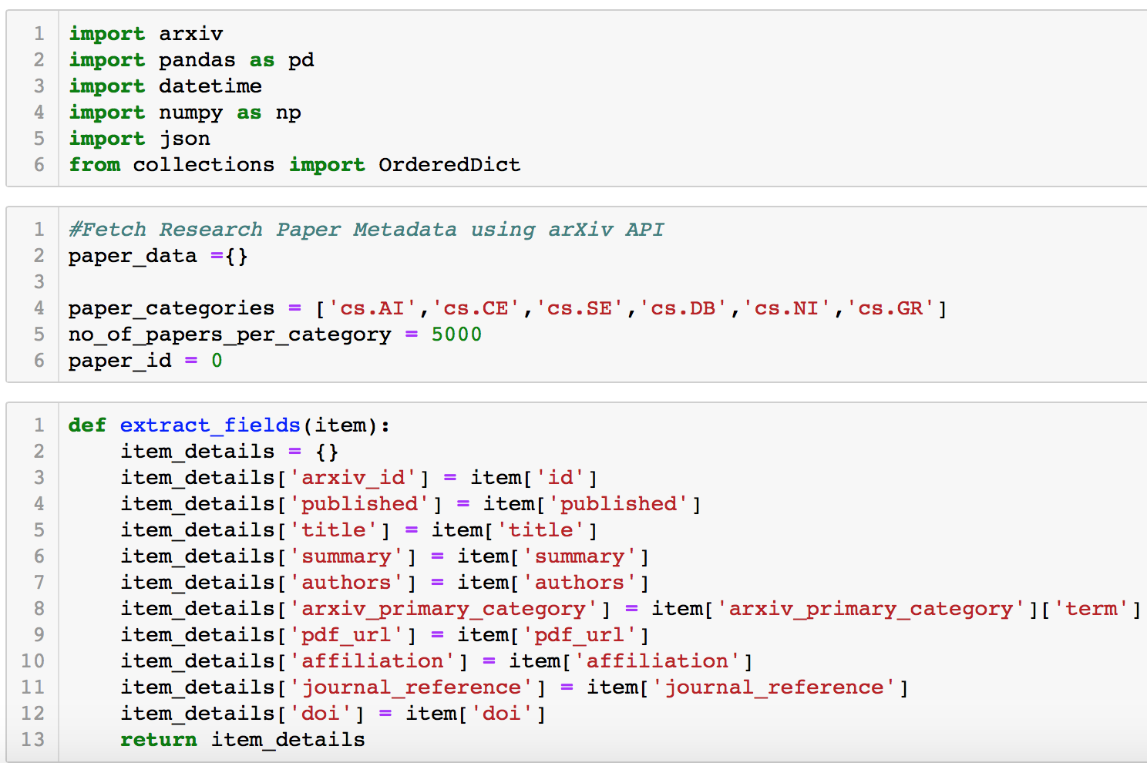
Research Paper Data Collection
Code snippet for fetching paper data:

Slide 10
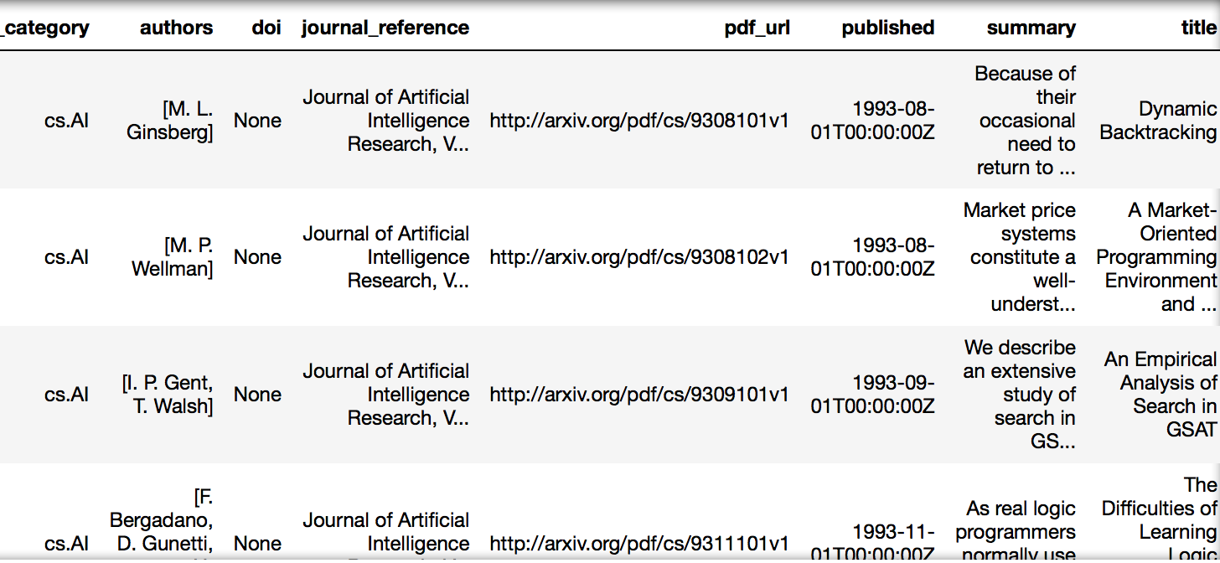
Research Paper Data Collection
Sample paper data after scrapping:

Slide 11
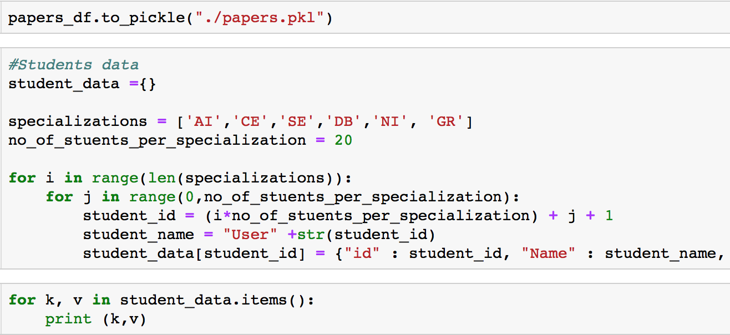
User Data Simulation
User data :
User data was unavailable. Simulated users as students from AI, CE, SE, GR, NI and DB specialization.
Code snippet for generating user data:

Slide 12
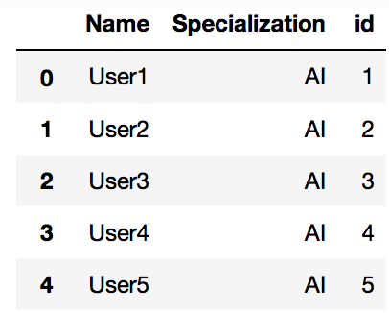
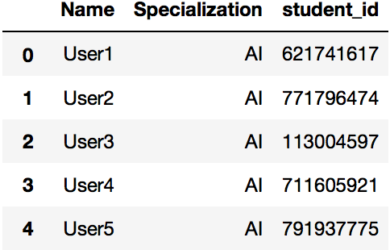
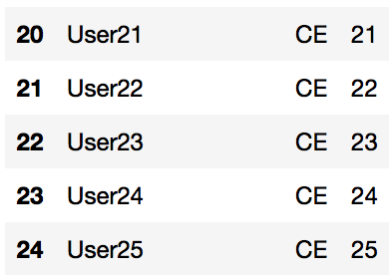
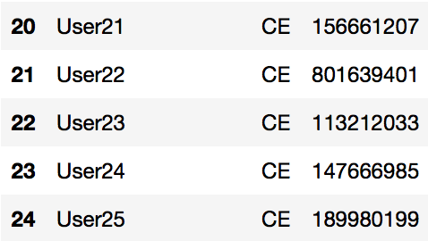
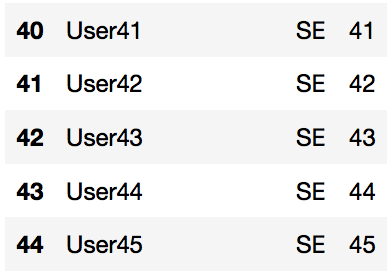
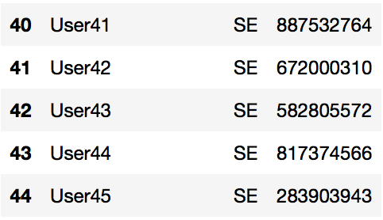
User Data Simulation
Before and after students data:

Slide 13
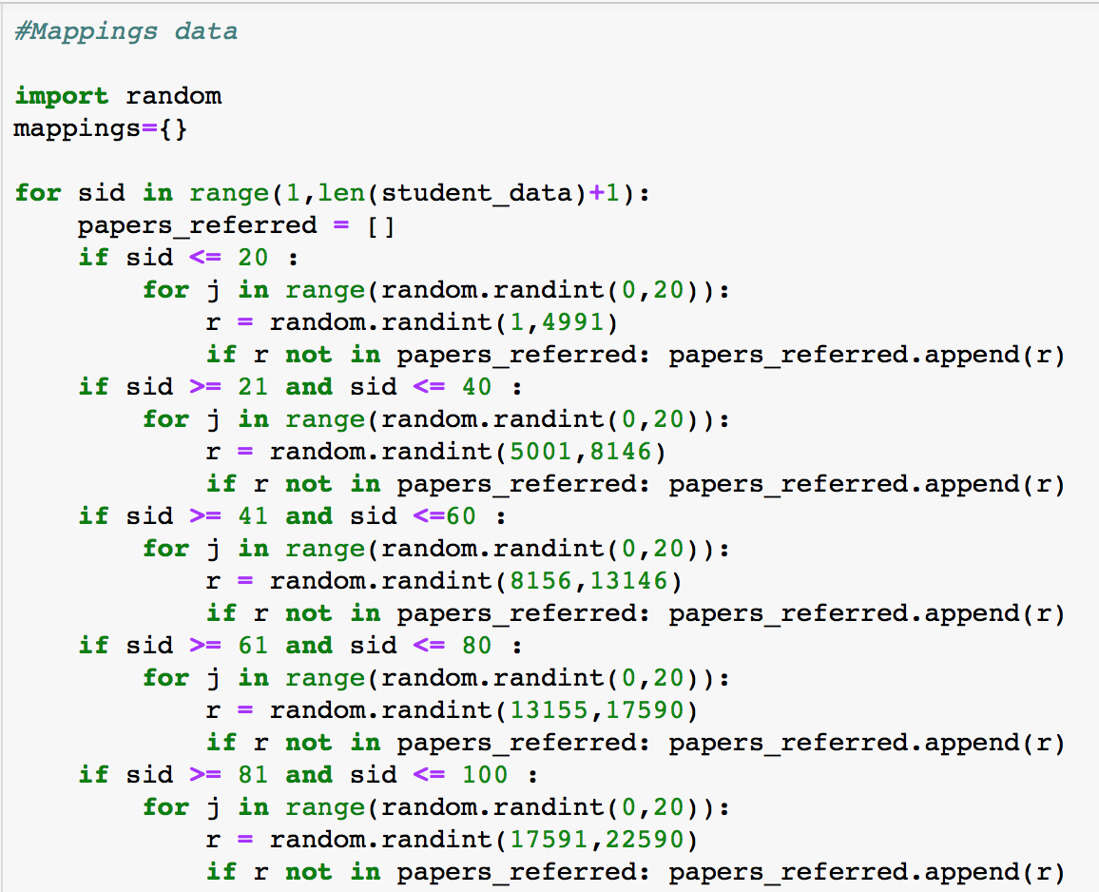
Mappings
Student-to-paper mapping :
Randomly assigned papers to each student indicating papers referenced by the student.
Code snippet for generating user data:

Slide 14
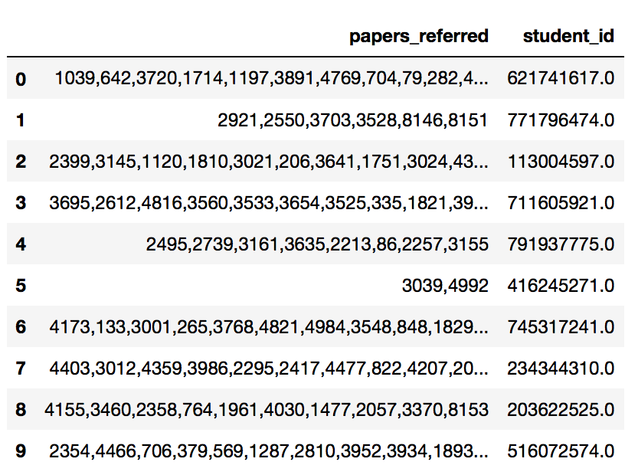
Mappings
Sample data after mapping:

Slide 15
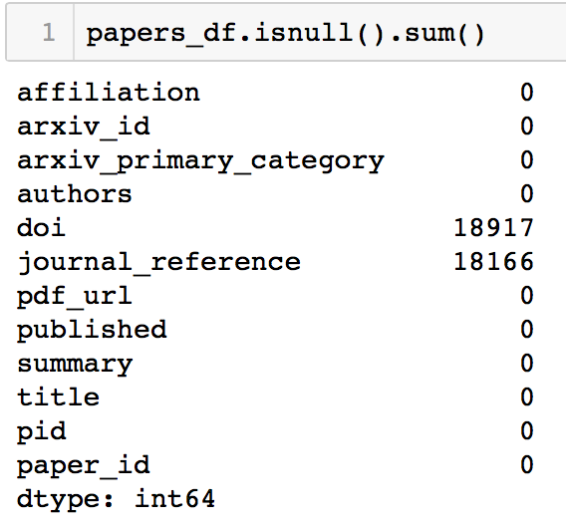
Data Cleaning
Remove missing values.
Remove duplicate values.
Gather statistics of students/papers.
Analyze students for each specialization with certain overlapping courses to get common papers.
Code snippet for data cleaning:

Slide 16
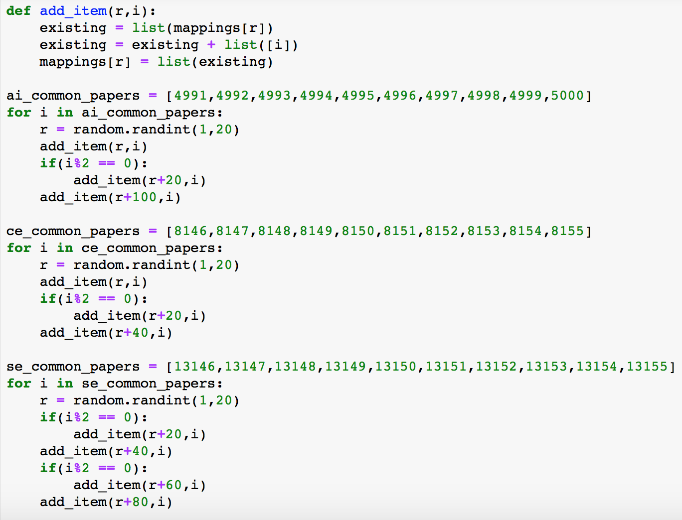
Data Analysis
Code snippet for calculating common papers:

Slide 17
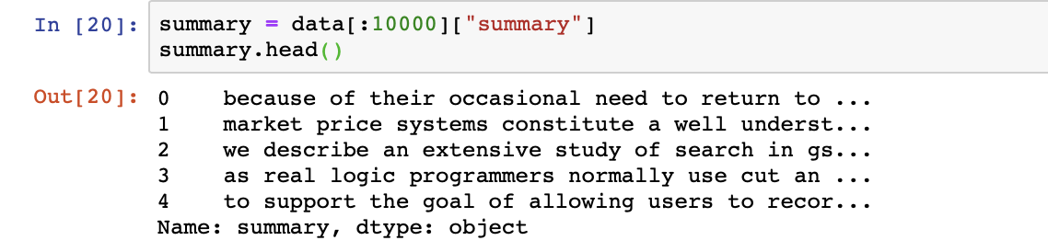
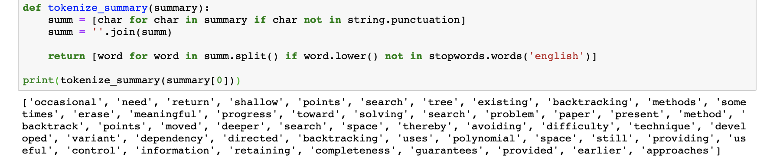
Data Pre-processing
Consider “Summary” column for calculating similarity between papers.
Remove “Stopwords” using NLTK.
Use TF-IDF to most and least occurring words.

Slide 18
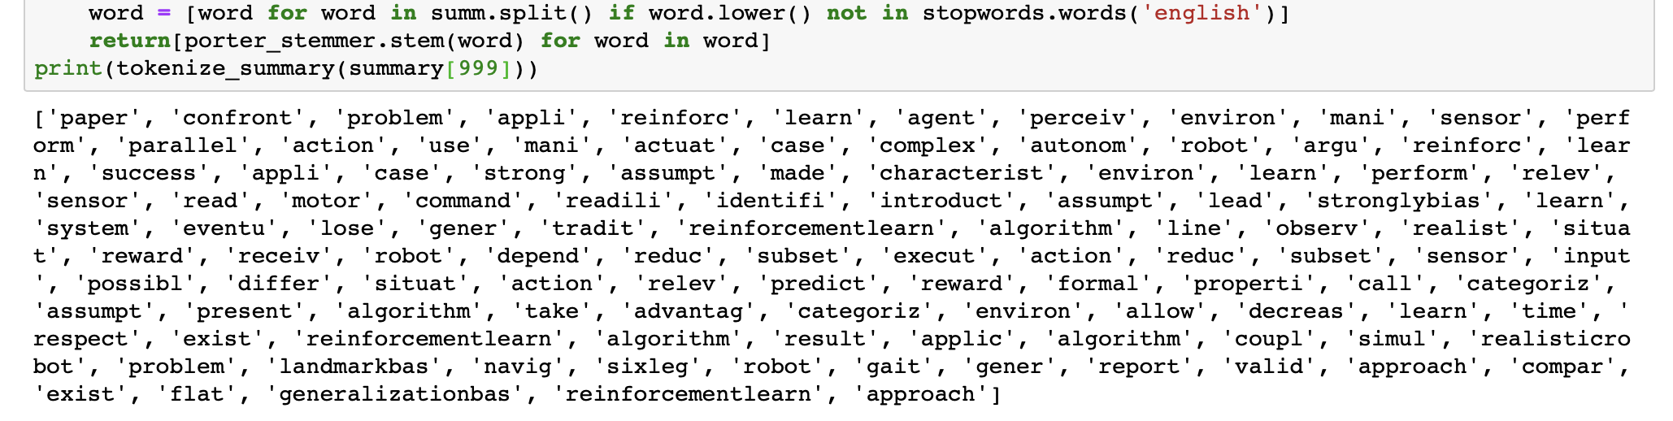
Data Pre-processing
Code snippet for stemming:

Slide 19
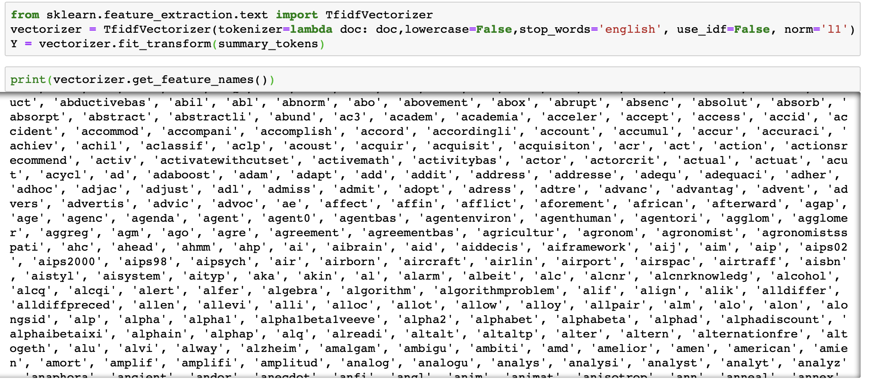
Implementation
Content Based Recommendation:
Collect papers referred by the student.
Calculate similarity between two papers using TF-IDF and cosine similarity.
Recommend top N similar papers.
Code snippet for finding keywords:

Slide 20
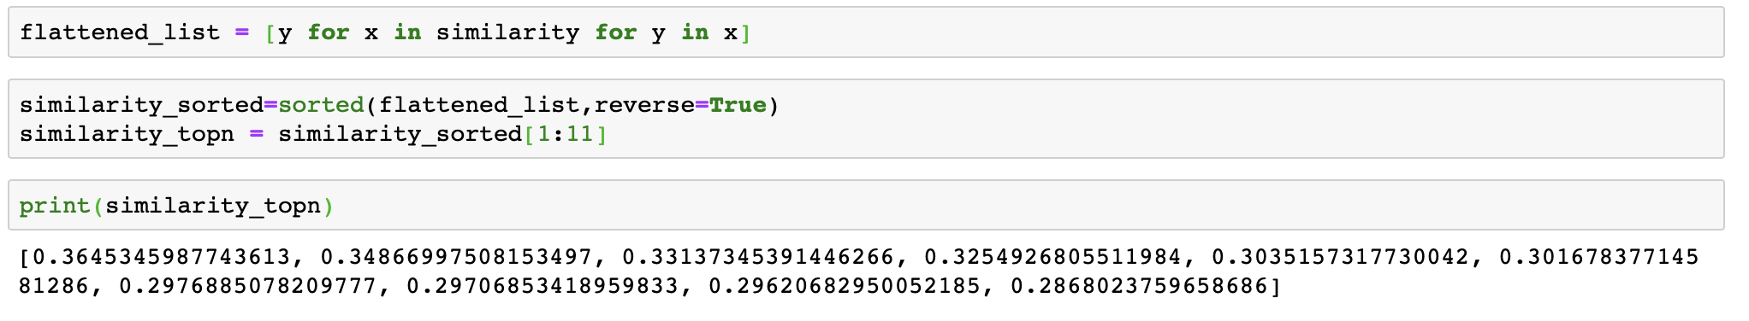
Implementation
Code snippet for content-based recommendations:

Slide 21
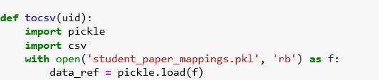
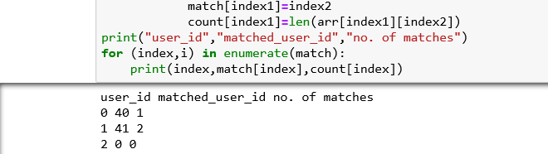
Implementation
Collaborative Recommendation:
Calculate similarity between students to get top N similar students based on the common referred papers.
Recommend papers referred by top N similar users which are not seen by the target user.

Slide 22
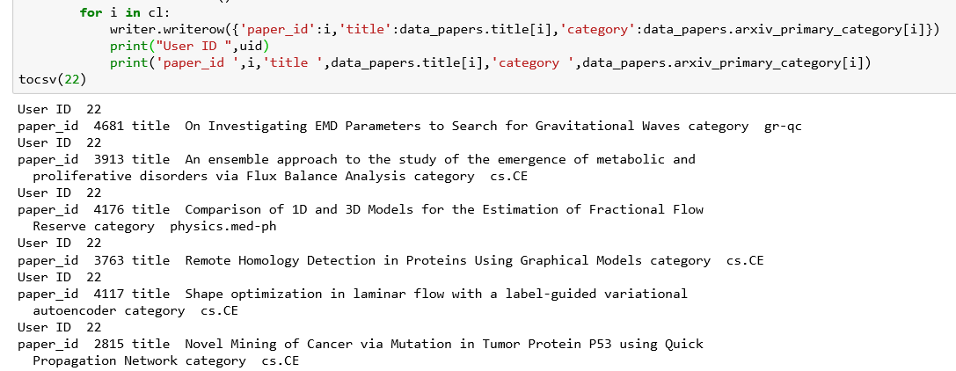
Implementation
Collaborative Recommendation:
Code snippet for collaborative recommendations:

Slide 23
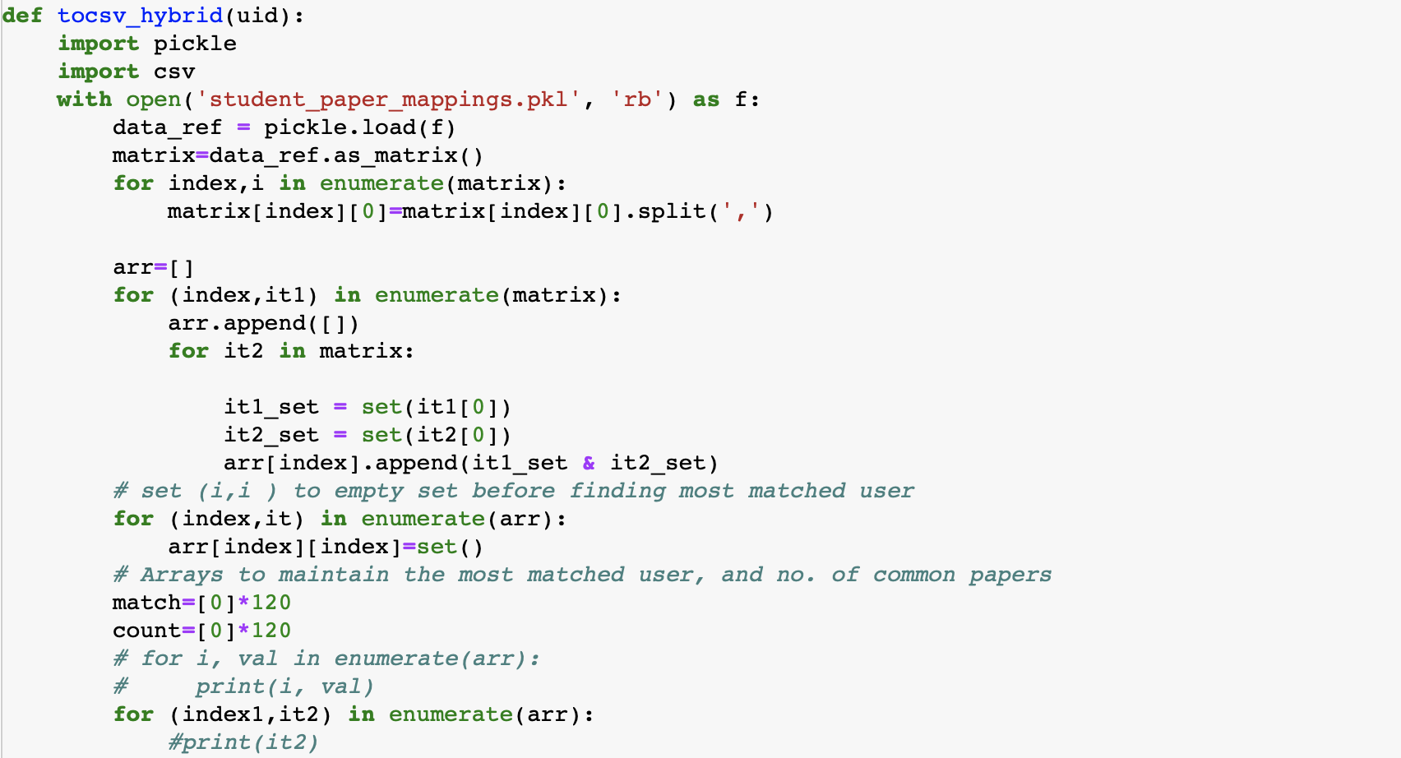
Implementation
Hybrid Recommendation:
Pipelined hybrid recommendation.
First run collaborative filtering to get top N recommendations.
Run content-based filtering on N recommendations to get new recommendations.
Code snippet for hybrid recommendations:

Slide 24
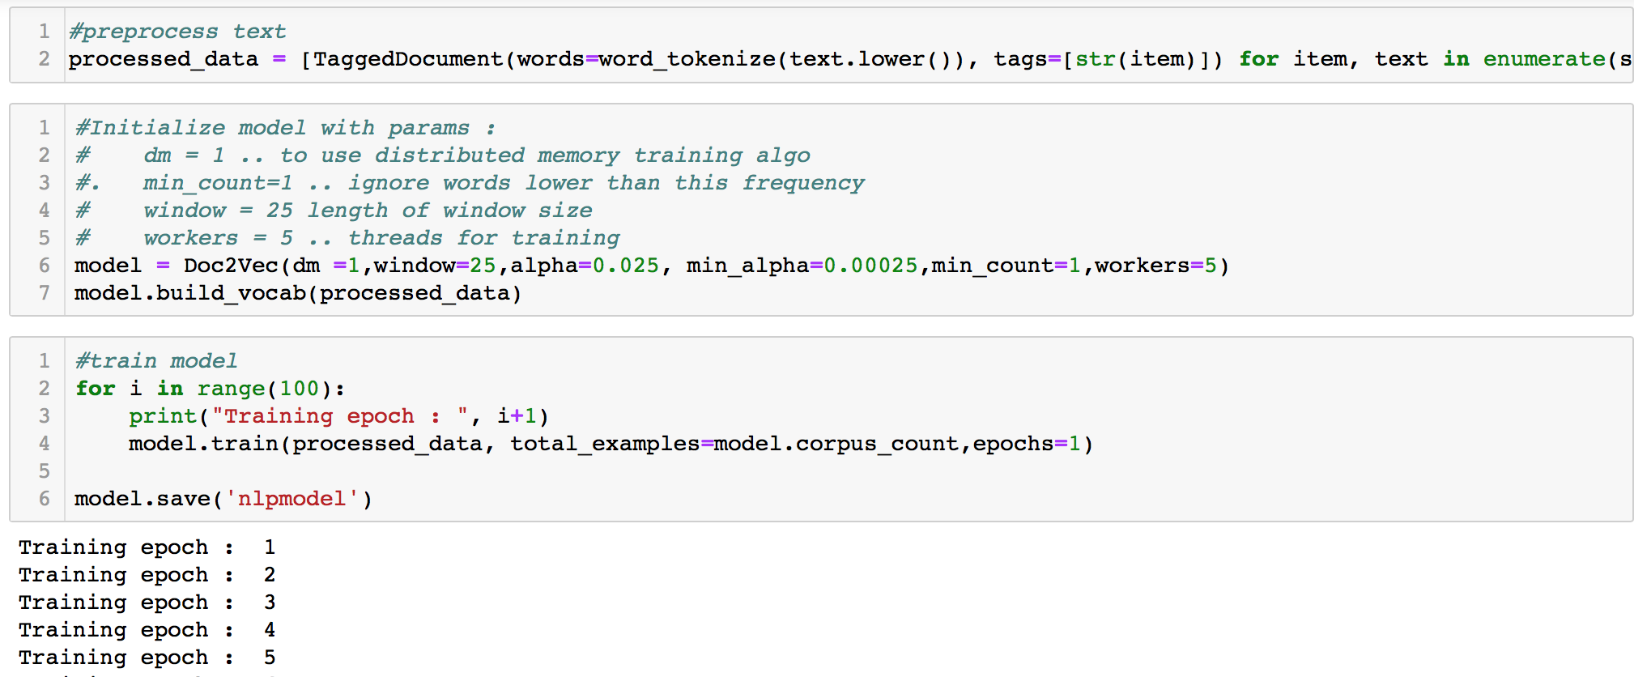
Implementation
NLP-Based Recommendation:
Implemented NLP and Doc2Vev using Gensim library to find correlated papers based on title and summary.
Distributed memory to preserve the order of words.
Distributed bag-of-words without considering the order.
Code snippet for implementing NLP:

Slide 25
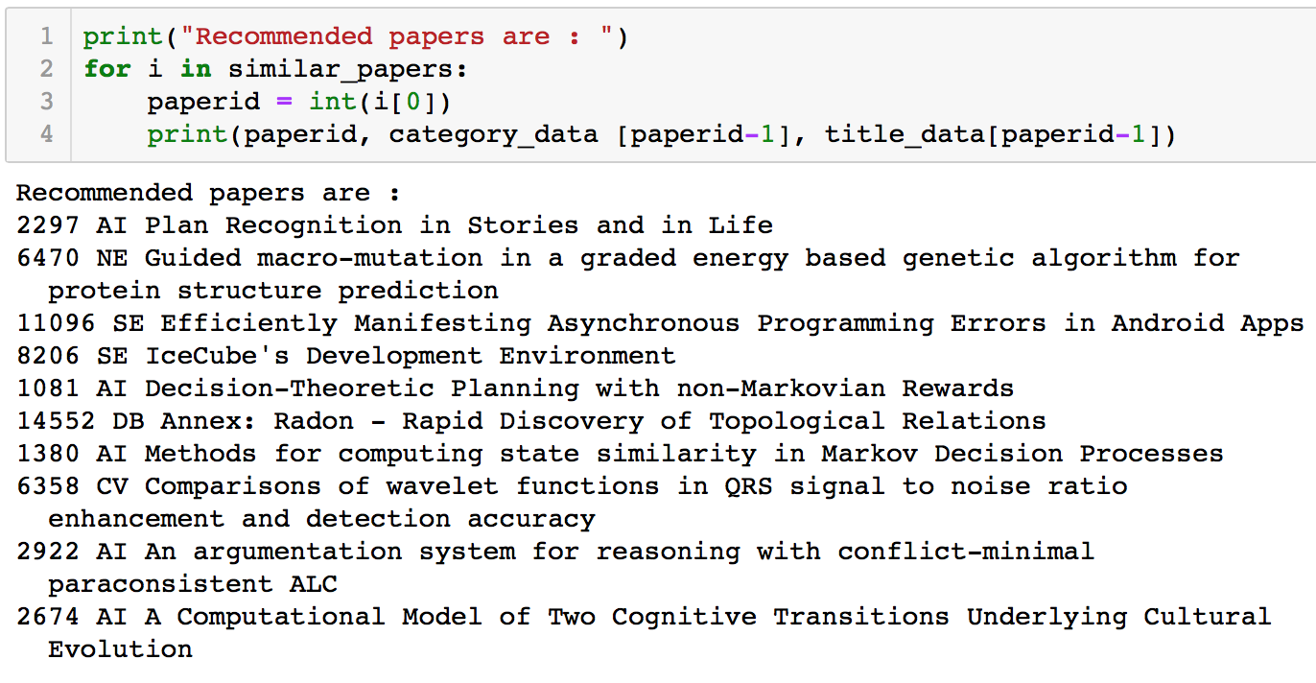
Implementation
Code snippet for NLP based recommendations:

Slide 26
Libraries
Natural Language Processing Kit (NLTK).
Word Tokenizer and Sentence Tokenizer from NLTK.
Word2Vec using Bag-of-Words or N-grams model.
Doc2Vec model from Gensim library.

Slide 27
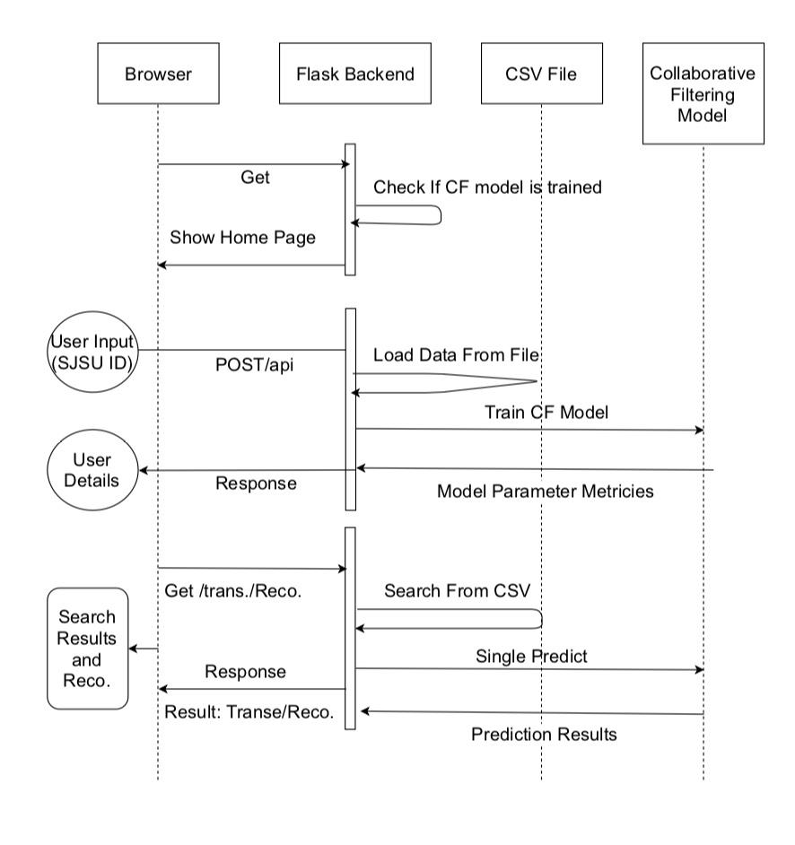
Workflow
Workflow:

Slide 28
Demo

Slide 29
Thank You

